Slide 1


Software Architecture Part 6
Code It Up Online Vol. 14

Slide 2
For LIVE questions
Check The Link In The Description
Resources https://github.com/ivaylokenov/Software-Architecture-Series

Slide 3
Live stream troubleshooting
Sometimes issues happen during a live stream…
And sometimes disasters happen, this is how memes are born…
If my Internet goes down and the stream stops:
Wait for 5 minutes, I have another one on a different network
If YouTube is showing “stream ended”:
I will post a new link in the comments section below this video
If something else happens unexpectedly:
Well, I will add a solution to this slide during my next event… ☹
If a major showstopper is happening – no electricity, for example
I will create a new event and we will schedule a new live stream…
In any case – write to wewritesoftware@gmail.com

Slide 4
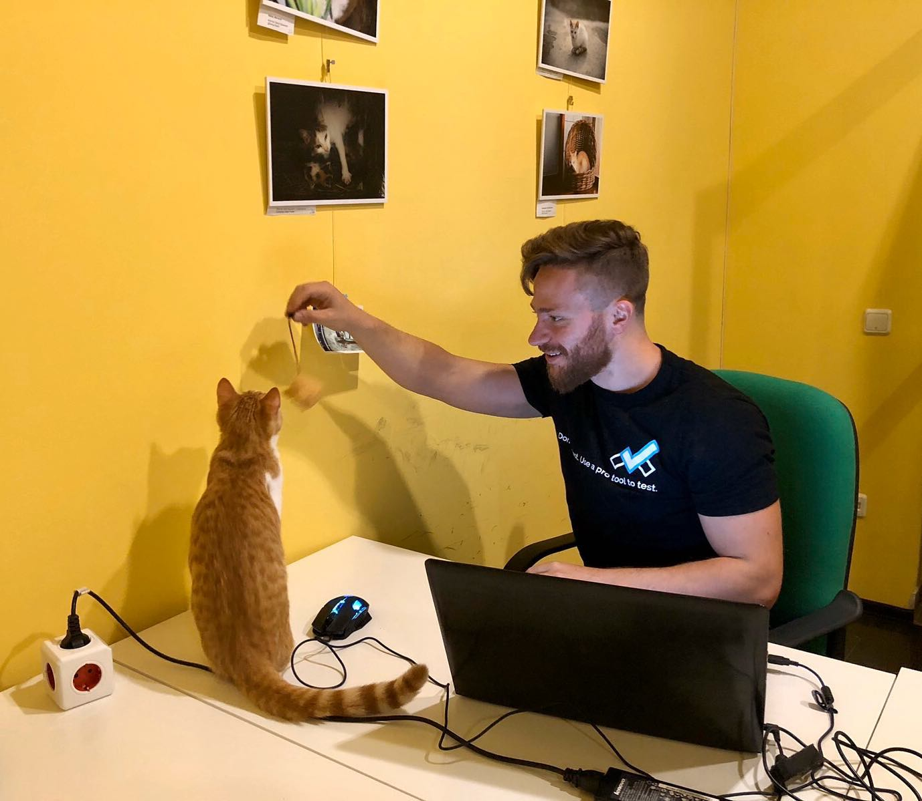
The Presenter
Ivaylo Kenov – Quality Code Advocate
Various job titles at the same time:
Organizer & Speaker @ Code It Up
CTO @ SoftUni
Full Stack Technical Trainer @ Everywhere
Code General @ https://docs.mytestedasp.net/
Meme Copy Machine @ Daily Programming Fun
{Insert Job Title Here}
Contacts
https://github.com/ivaylokenov
https://facebook.com/ivaylo.kenov
https://linkedin.com/in/kenov
https://www.instagram.com/ivaylokenov/
YouTube & Blog
https://www.youtube.com/c/CodeItUpWithIvo
https://codeitup.today/

Slide 5
Sponsors
This lecture is free thanks to our sponsors
Which will interrupt the lecture here and there
Because it takes quite a lot of personal time to prepare the materials
You will help the initiative a lot if you visit their web sites
And consider their propositions to you
I personally select various premium jobs to present them during the talk
These are the current ones:
INDEAVR - https://indeavr.com
Americaneagle.com - https://www.americaneagle.com
SmartIT - https://smartit.bg

Slide 6
ABOUT CODE IT UP

Slide 7
Code it up
The Code It Up initiative:
Aims to provide detailed knowledge on advanced software development topics
Aimed at people with at least 1 year of programming experience (mostly C#)
Sort of acquired by SoftUni last year
Code It Up Online
Free live-streamed online events (2+ hours long)
Led by me – mainly .NET, architecture, and infrastructure
We have 6 more lectures before the initiative ends
Code It Up Workshop
Paid events containing theory & practical exercises for the attendees
No more paid lecture planned for now

Slide 8
Thankful if you share a story
You can be extremely helpful to the initiative
Just share a story on Facebook or Instagram during the lecture
Make sure you tag me so that I can reshare your post - @ivaylokenov
Bonus – add the #codeitup hashtag
Thank you! You rock!

Slide 9
ABOUT The Series Of Events

Slide 10
About This SERIES Of Code It Up Events
Theoretical lectures on software architectures
Widely-used design patterns and concepts in production
Depending on your level, you may be familiar with some of the topics
A real-life project example
A practical guidebook for architecting various solutions
3 real-life projects on more than 70 pages
Legacy systems, vast data load, lots of concurrent users, working with critical data, and more
Please report to wewritesoftware@gmail.com, if you find any “bugs” in the book!
And I have a lot more to add in the future!
You receive free updates of the book!
MOST IMPORTANTLY – HUGE THANK YOU! <3

Slide 11
The Content Of The Series – A Free Course
Why Software Architecture
What Is Software Architecture?
Unified Modeling Language
Designing Solution Architectures
Common Technology Stacks
Architecture Design Patterns
Choosing The Right Patterns
Architecture Quality Attributes
System-Wide Considerations
Deployment Considerations
Monolithic Architecture
Domain-Driven Design
Microservices
Event Sourcing
The Architecture Document
The Architect And The Team
What Makes A Great Architect
Designing A Real-Life Solution

Slide 12
in The previous parts
Designing Solution Architectures
Common Technology Stacks
Architecture Design Patterns
Quality Attributes & Considerations
Low-Level Architecture
It is not required to watch the parts in order
But it is strongly advised!
Get the previous recordings from here:
https://www.eventbrite.com/o/code-it-up-29733808833

Slide 13
in this part
Microservices Architecture
Distributed Data
Event-Driven Communication
Avoiding Disasters
Don't Forget The Optional But Practical Guide-Book
3 Real-World Scenarios
70+ Pages
Free Updates
Get It From The Event's Page or write to wewritesoftware@gmail.com
https://www.eventbrite.com/e/software-architecture-microservices- code-it-up-online-vol-14-registration-262477656737

Slide 14
About this topic
HUGE DISCLAIMER! THIS TOPIC IS LIKE THE LITTLE PRINCE BOOK!
There are a lot of things to know about software architectures
You may or may not recognize some of the patterns
And we most probably will not mention all of them
If you are a beginner, just try to absorb what you can
The technology world is moving very fast
Some of the examples shown here may be considered anti-patterns in the future
But the overall concept and process stays the same
As all my other topics – this one is super intense too!
Even though the lectures will be a bit shorter
So, give yourself time and if you get the book – finish it!
And don’t worry! The knowledge provided here will save you weeks of reading!

Slide 15
INDEAVR – The EVENT’s DIAMOND SPONSOR
They provide technology services focused on the Digital, Data, Cloud and Advanced Software Engineering expertise.
They are always in search for creative and passionate people with the combination of a sharp strategic mind, emotional maturity, entrepreneurial instincts, and the ability to deliver results.
https://www.indeavr.com/en/technology/application-services
https://www.indeavr.com/en/careers

Slide 16
Microservices Architecture

Slide 17
Let’s start with monoliths
Externally, a monolith is an application which
Is deployed as a single process
A single web application, solving all business requirements
A single process
You may use a container to simplify deployment
Internally, a monolith application is separated
Different layers – web layer, domain layer, service layer, etc.
You scale these by replicating them
And adding a load balancer in front of them

Slide 18
Let’s start with monoliths
Benefits:
Simple development
Simple testing
Deployment is easy – single VM or container
Scaling is also easy to a certain extend
Drawbacks:
Huge applications have huge complexity
Slow startup time when the application grows
Each update redeploys everything
Continuous deployment is difficult
Bug in any module – brings down the whole application
Expensive to update dependencies

Slide 19
And move to microservices
Microservice-based application:
Has many applications with different domains, working together
Usually for the back-end, but it is also used for the front-end
Each service runs its own process and communicate to others
Communication is done through HTTP(S), Web Sockets or Advanced Messaging
Each microservice has a context boundary and it is developed autonomously
Each microservice has its own isolated data layer
Size is not important. Internal cohesion and independence are!

Slide 20
And move to microservices
Benefits:
The complexity is decomposed
Different teams work on different services
Deployment is as independent as possible
Services may be scaled independently
Drawbacks:
Complexity because of the distribution
Database needs eventual consistency and developers must be more careful
Developers need to handle partial failures
Debugging and deployment are more complex
Changes that span multiple services are more difficult to implement
Network starts to be a “thing”

Slide 21
And move to microservices
How to build successful microservices
Monitoring and health checks
Scalable infrastructure – cloud and orchestrators
Security design at multiple levels – communication, authentication, authorization
Rapid application delivery – usually with different teams
DevOps and CI/CD practices
Microservices are challenging and should require careful thinking!
Do not use them as a golden hammer or because of a hype!
Here is a C# microservices example:
https://bit.ly/micro-code

Slide 22
Data in Microservices

Slide 23
Data in microservices
Important rules of microservices:
They should own their logic
They should own their data
The conceptual model may differ and that’s OK
Each microservice has its own Bounded Context
In traditional applications we have:
One or multiple databases (or equal)
It looks simpler initially, but the application ends up with huge tables which serve different subsystems
The ACID transactions are a huge advantage of the monoliths
Atomicity, Consistency, Isolation, Durability

Slide 24
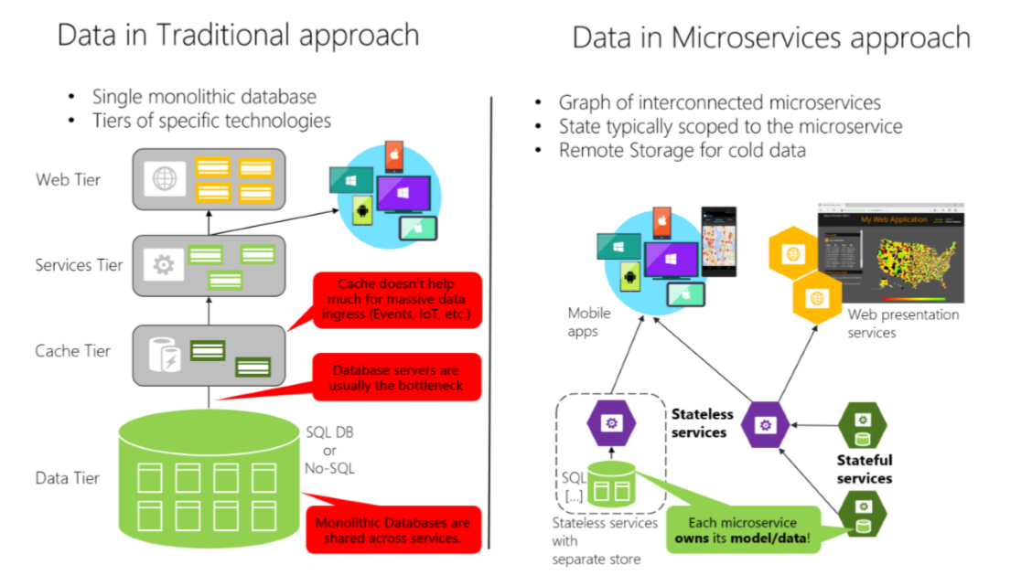
Data in microservices

Slide 25
Data in microservices
Data in microservices is very different
Much more complicated
Data owned by a microservice should be private to that microservice
The only way other microservices can access it are through its
API - REST, RPC, etc.
Messaging – AMQP
Encapsulating data allows you to have loosely coupled microservices
Which can evolve independently
Consider data schema migrations

Slide 26
Data in microservices
With distributed data structures, you cannot do a single ACID transaction
You need to use eventual consistency
When a business process spans multiple microservices
It is much harder than a normal SQL JOIN
There are no constraints
Most relational database features cannot be fully utilized
This does not mean you must use NoSQL database
It means data management is more complex
Different microservices can use different databases

Slide 27
Back to The BOUNDED CONTEXT

Slide 28
The bounded context
Central pattern in DDD and Microservices
Its focus is dealing with large models by dividing them into logical groups – Bounded Contexts
The logical groups should be very explicit about their relationships
Each Bounded Context has
Unrelated concepts – such as support ticket in a customer support context
Related concepts – products and customers
Different context may have completely different models of common concepts
But may share the same data identity

Slide 29
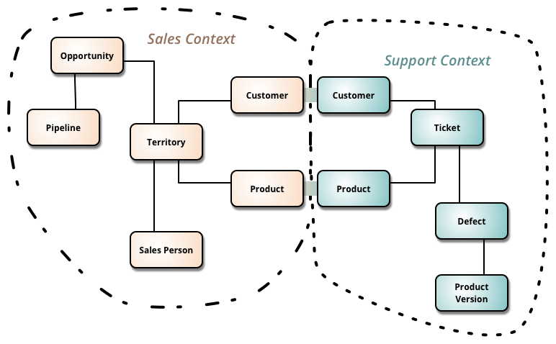
The bounded context

Slide 30
The bounded context
A microservice is like a Bounded Context
A separate process for each Bounded Context
With protocols for communication – HTTP, Web Sockets, or AMQP
Defining a microservice for each Bounded Context in your business domain is a good start
But don’t be constrained by it
Sometimes a Bounded Context have multiple microservices
Just don’t create nanoservices!

Slide 31
BEFORE WE CONTINUE…

Slide 32
Huge THANKS for your support & TRUST!
Everyone who got a paid ticket – 53 people in total! Thank you!
Top supporter – Georgi Georgiev – 50 BGN! Thank you, you rock! <3
Thanks to – Nikolay, Nikolay, Vladimir, Ivaylo, Pavel, Georgi , Albena, Ani, Nikolay, Борислав, Diana, Владимир, Mariyana, Mira, Borislav, Владимир, Radoslav, Teodor, Hristo, Калин, Stoil, Emiliyan, Daniel, Petar, Мирослава, Svetoslav, Zlatko, Рая, Elitsa, Lyuboslav, Teodor, Svilen, Dinyo, Nikolay, Hristo, Иван, Tanya, Sonya, Petar, Grigoris, Hristina, Yavor, Plamen, Ivan, Iva, Petar, Tugay, Dimitar, Kalina, Ivelin, Viktor, Ivan, Ivaylo
And everyone who supported the initiative during the years!

Slide 33
These events are not Exactly free
I prefer to call them “Pay what you want”
Depending on how much you value the provided knowledge
It takes me a considerable amount of free time to prepare these lectures
And I want them to be perfect and complete!
I put my soul in them!
For this reason, I will be extremely thankful, if you decide to support me and my projects!
It is never expected, but always appreciated!
The easiest way is via
PayPal: http://paypal.me/ivaylokenov
Revolut: @ivaylokenov

Slide 34
Logical VS Physical Architecture

Slide 35
Logical VS Physical Architecture
There is a distinction between the logical and the physical architecture
The logical boundaries of the application do not need to map one-to-one to the physical deployment architecture
If you identity your Bounded Contexts, it does not mean that it is best to implement each one as a microservice
Some Bounded Contexts may need multiple physical servers
As long as your Bounded Context is independently versioned, deployed, and scaled
Most commonly you will have one microservice per Bounded Context but that should not be a strict rule

Slide 36
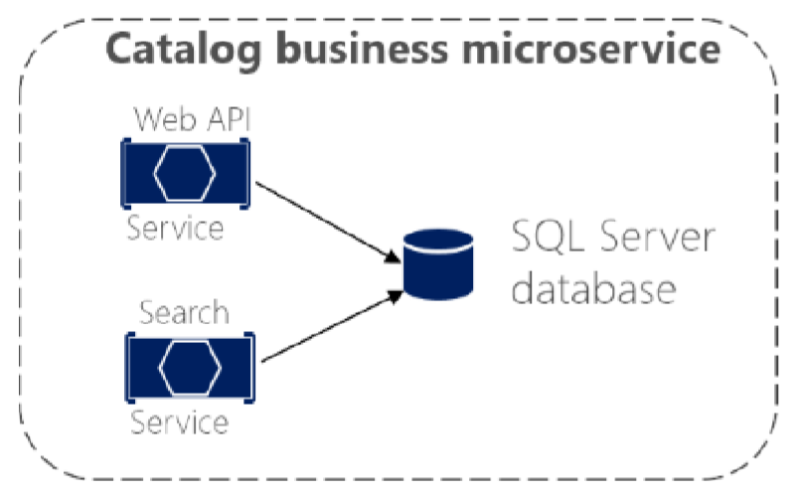
Logical VS Physical Architecture
Consider the following catalog microservice
You may decide to split the internal servers, so that you can scale them better

Slide 37
DISTRIBUTED DATA Challenges

Slide 38
1. HOW TO DEFINE BOUNDARIES
Each microservice should be autonomous, yet part of the whole system
First try to identity “islands” of data and different business contexts
Then try to define the entities in each business context
Some entities may be the same with different names
For example – a user can be user, buyer, and customer at the same time
The main goal is to minimize the coupling between the contexts

Slide 39
2. Query than span multiple services
Often, you will need to retrieve data from multiple microservices
While avoiding too much “chitty-chat” between them
Examples:
User information from the Identity, Catalog and Shopping Cart services
Complex report involving many tables across the system
You do not have a simple solution and it depends on the query
API Gateway
CQRS with query/read tables
“Cold Data” in central databases

Slide 40
3. Query than span multiple services
API Gateway – separate microservice for aggregation purposes
Be careful with this one, it may lead to a chokepoint
You can create multiple fine-grained gateways for different “verticals” of the business
CQRS with query/read tables – generate in advance the data in a read-only table
Improves performance, but needs additional work and eventual consistency
You should use event-driven communication to update the tables
“Cold Data” in central databases – extract separate databases
For complex reports with no real-time data
Event-driven communication or database import/export tools
NOTE: If you constantly need data from multiple services that may be a bad design and consider merging microservices into a single entity (remember nanoservices?)

Slide 41
4. Consistency between services
The challenge is to implement end-to-end business processes while keeping consistency across microservices
An example:
Catalog microservice – maintains information about products (including price)
Shopping Cart microservice – maintains current chosen products and price
When a product price is updated – you need to update the cart too (and show a message)
In monolithic application this should be fairly easy
But with microservices – no service should include tables/storage from another one
And it should never call direct queries to them
Solution is event-based communication
Publish-Subscribe pattern

Slide 42
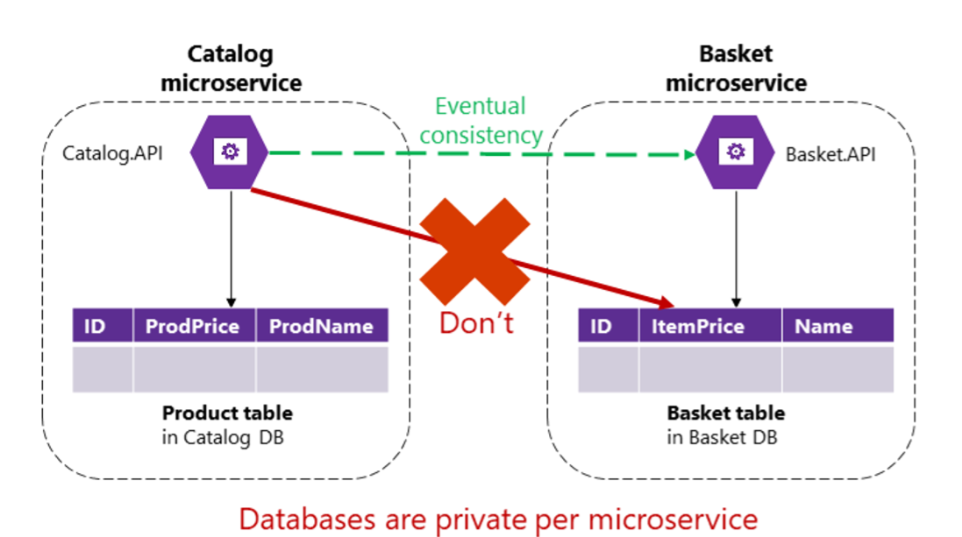
4. Consistency between services

Slide 43
5. Communication between services
The challenge about communication is not so much about the protocols
But more about the style and couplings
Because when failure occurs - the more coupled the system, the bigger issues you will have
Partial failures will happen, so you need to design the system considering the common risks

Slide 44
5. Communication between services
For example – popular approach is request-response, because it is simple
HTTP is perfectly acceptable, but it depends on how you use it
RPC is also a great substitute for internal HTTP communication
Acceptable request-response communication types are:
Client-Microservice
Client-API Gateway
API Gateway-Microservice
Unacceptable request-response communication type is:
Microservice-Microservice

Slide 45
5. Communication between services
Consider the following scenario:
The client call the Orders microservice
Then the Orders microservice calls additional microservices for more information
Sounds reasonable at first
But these are the pitfalls:
Blocking and low performance – scalability is impacted
HTTP coupling on a business level – this should not occur
Failure will be difficult to manage – and failures occur
This way – we achieve a monolithic application across many processes
Solution is event-driven asynchronous communication

Slide 46
Identifying boundaries

Slide 47
Identifying boundaries
The goal is not to make as granular microservices as possible
Nanoservices are bad!
The goal is to have the most meaningful separation
Cohesion is the key to separate the microservices
Keep in mind that finding the right “size” is not a one-shot process
The microservices will be continuously evolving
A common way is to split the contexts by the company’s social boundaries
But sometimes it may be the opposite
Duplicated data is completely OK!

Slide 48
Identifying boundaries
Key results for success:
Few strong relationships between contexts
You don’t need to merge information for common processes
If you can work with a microservice without constantly switching to other microservices
Autonomous bounded context
Volatility-based decomposition is super-important!
Design for potential changes and not for functionalities or domains!

Slide 49
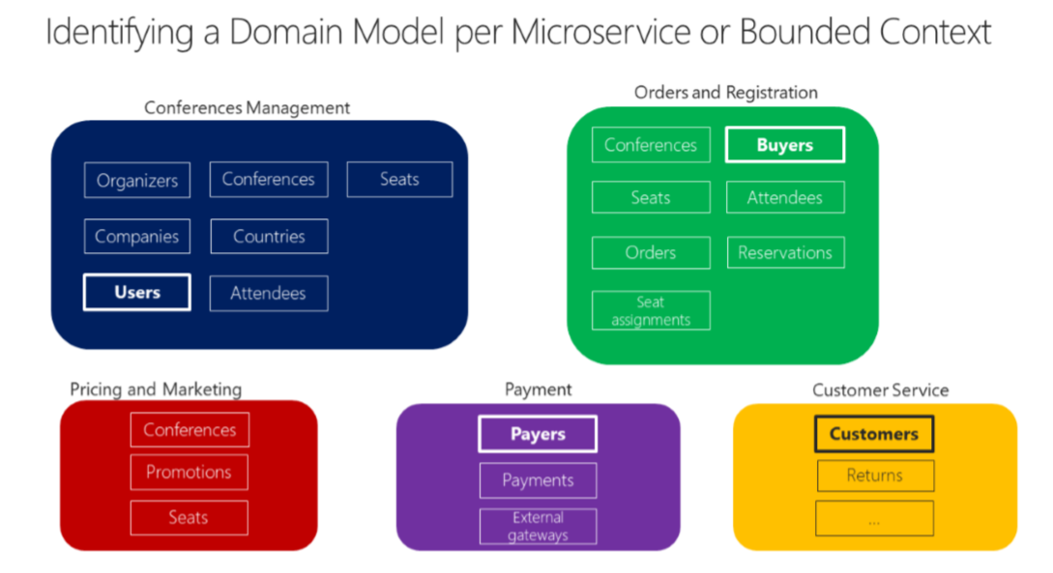
Identifying boundaries

Slide 50
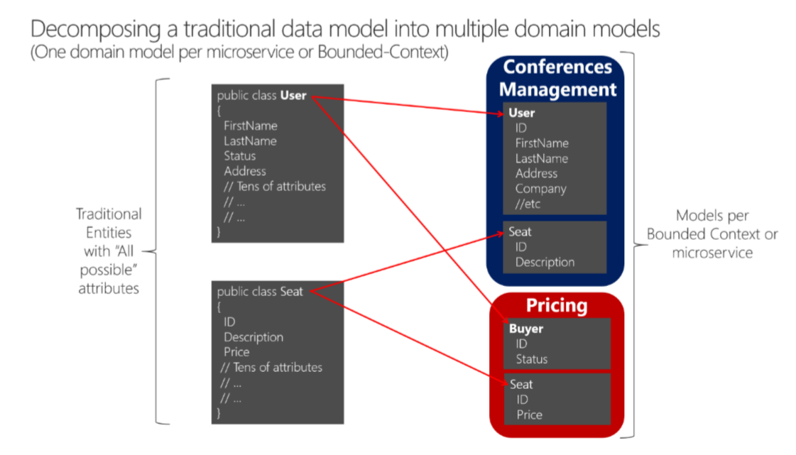
Identifying boundaries

Slide 51
THE API GATEWAY

Slide 52
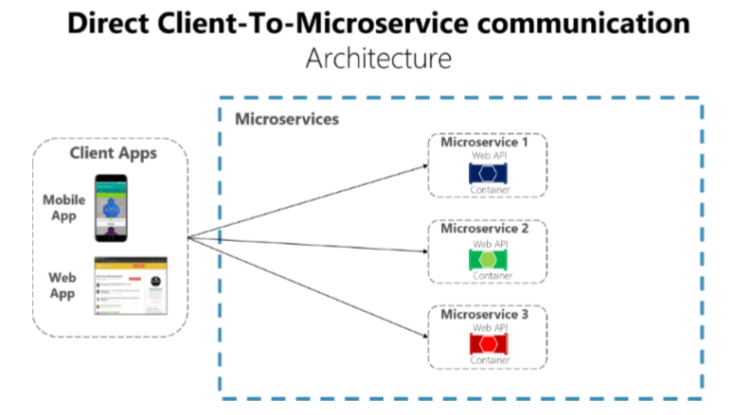
Direct Client-Server Communication

Slide 53
Direct Client-Server Communication
Works great for small applications
Too much web requests, increasing the application latency
Authorization is more difficult to implement
It must be done on every microservice
Handling too many endpoints on the client may become a nightmare
Coupling to many microservices
Cross-cutting concerns such as SSL need to be implemented everywhere

Slide 54
THE API GATEWAY
Provides single-entry endpoint for a group of microservices
Like the Façade design pattern
Also knows as “backend for frontend”
You build it for the specific client needs
Acts as a reverse proxy and man in the middle between the clients and the microservices
Can also provide authentication, cache, and other cross-cutting concerns
Perfectly acceptable for request-response communication
HTTP or RPC

Slide 55
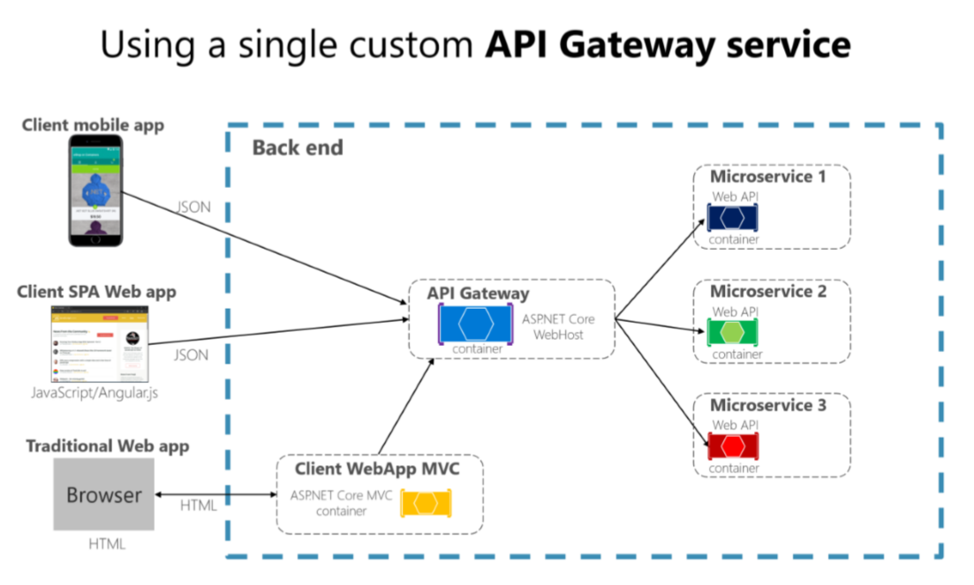
THE API GATEWAY

Slide 56
THE API GATEWAY
If you are not careful, the API gateway may become a full monolithic app
Bloated with too many endpoints
Couples all microservices, destroying their benefits
API Gateways should also be segregated
At first it may be an API Gateway for each client
But then it may be further split by logical groups based on business boundaries

Slide 57
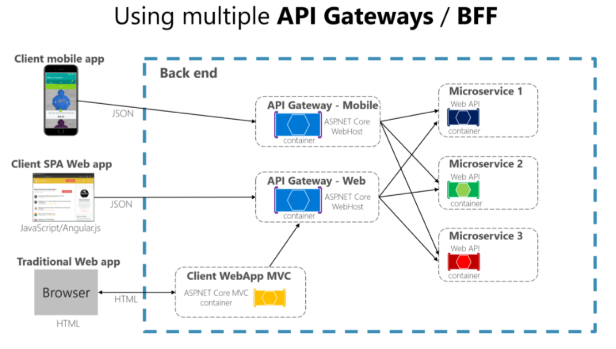
THE API GATEWAY

Slide 58
THE API GATEWAY - Benefits
Reverse proxy and routing
Decouples the client
Modernize legacy monolithic app
Hide the internal microservices
Request aggregation
Reduces chattiness between client and microservices
Especially important for remote applications
Offloading
Authentication, load balancing, retry policies, response caching, IP whitelisting, and more

Slide 59
THE API GATEWAY - Drawbacks
Coupling with the internal microservices
Additional point of failure
Additional network calls
Usually does not have a huge impact considering the alternative
May become bottleneck
Additional development costs and maintenance

Slide 60
Communication

Slide 61
Communication Types
Sync or Async
Synchronous – HTTP/HTTPS – tasks can continue after the response
Asynchronous – AMQP – the client usually don’t expect a response
Single or Multiple receivers
Single receiver – the Command pattern
Multiple receivers – the Publish/Subscribe pattern
Microservices usually uses a combination of these communication types
If possible, never depend on request-response communication
It breaks the autonomous feature of the microservices
And may turn into a bottleneck
Always consider “the rule of 1 hop”

Slide 62
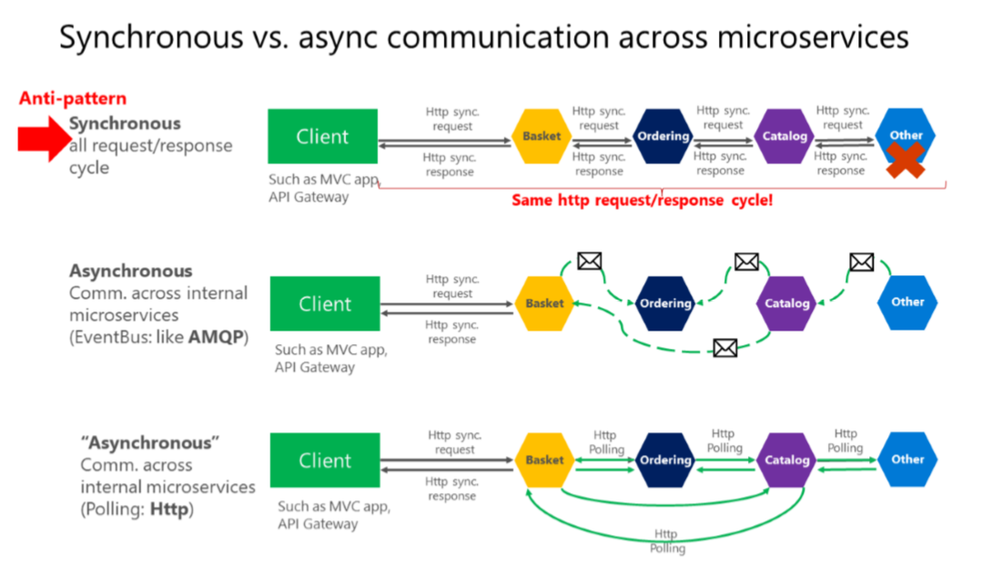
Communication Types

Slide 63
Communication Patterns
Don’t rely on request-response, if possible
If you need data from another microservice, consider duplicating it!
It is perfectly OK!
If your microservice needs to invoke an action in another microservice do it asynchronously
You can use any protocol to transfer data to have eventual consistency
But don’t create synchronous dependencies by waiting for responses

Slide 64
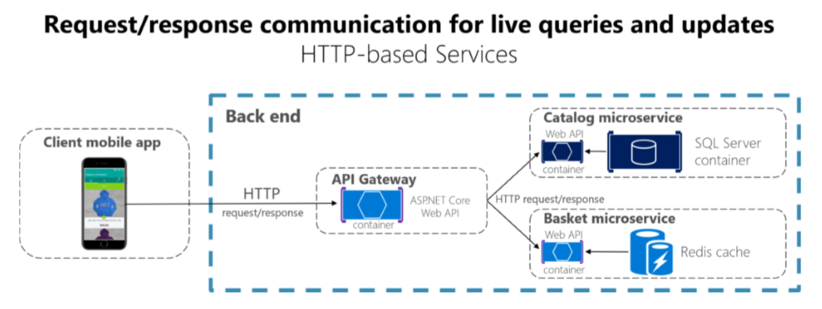
REQUEST-RESPONSE
Suitable for UI needs and fast responses
Usually used for queries

Slide 65
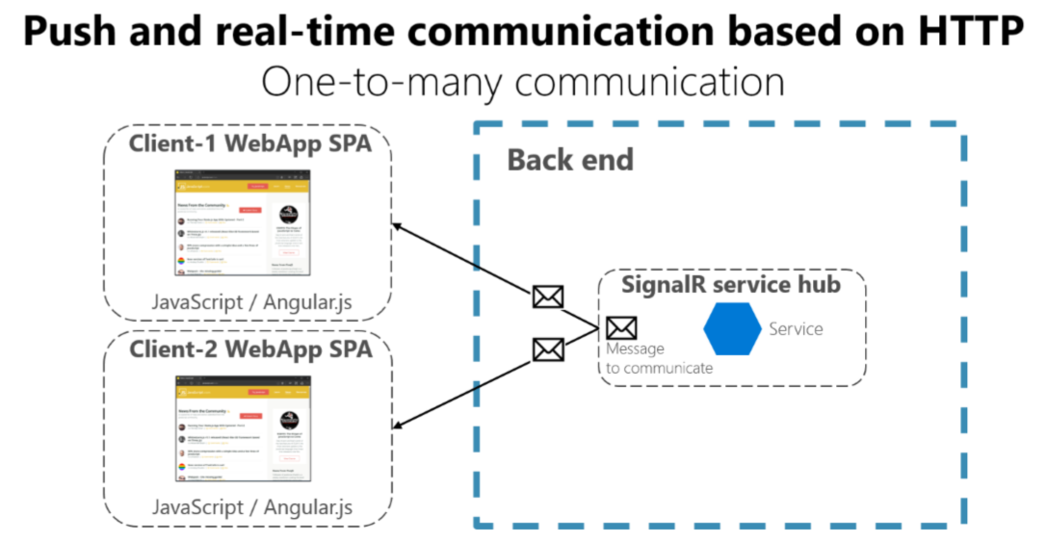
Web sockets
Suitable for real-time UI data

Slide 66
Asynchronous messages
Critical for propagating changes throughout multiple services
Eventual consistency + event-driven communication
A client send a message (header and body) and do not expect a response
If the service needs to return a response – it sends another message
Usually sent asynchronously through AMQP
The preferred infrastructure is a lightweight message broker
Like RabbitMQ or a cloud-ready service bus
Rule is:
Use HTTP for client + API Gateway + First microservice level (Frontend microservices)
Use AMQP for service level (Backend microservices)

Slide 67
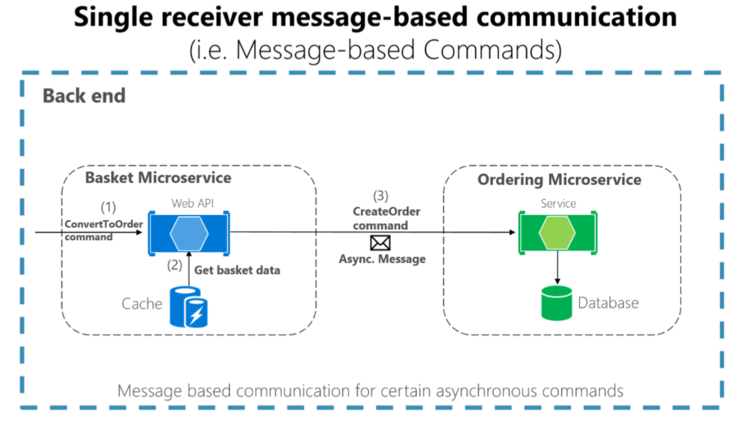
Single receiver

Slide 68
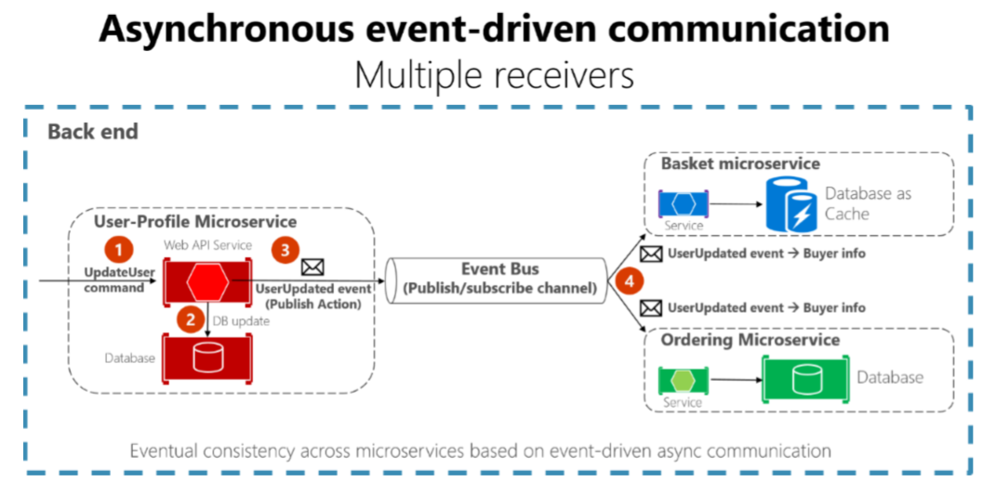
Multiple receivers

Slide 69
Asynchronous messages - Problems
The operation is not atomic
What will happen, if network fails?
Possible solutions:
Transaction log mining
Creates coupling to the database
The Event Sourcing pattern
The full pattern requires serious rearchitecting
The Outbox pattern
A separate table, holding the events, part of the transaction

Slide 70
Asynchronous messages – atomicity
Create an additional table holding the integration events between microservices
Before publishing to the event bus – create a local database transaction
Updating the entity and saving the event as “pending”
Publish the event for the other microservices
If the publishing is successful – mark the event as “completed” with a new transaction
Have a background job to check periodically for failed “pending” events and publish them to the event bus
Guarantees you eventual consistency
Make sure you save yourself from database failures too!

Slide 71
Asynchronous messages – atomicity
The receiver microservice should do one of the following
Make sure the operations can be performed multiple times without affecting the result
Recognize duplicated messages and discard them
Idempotent messages:
Should be like “set the price to $40.00”
And not like “add $5.00 to the price”
Recognizing events can be done by adding a GUID to every event
Or use the infrastructure’s built-in features

Slide 72
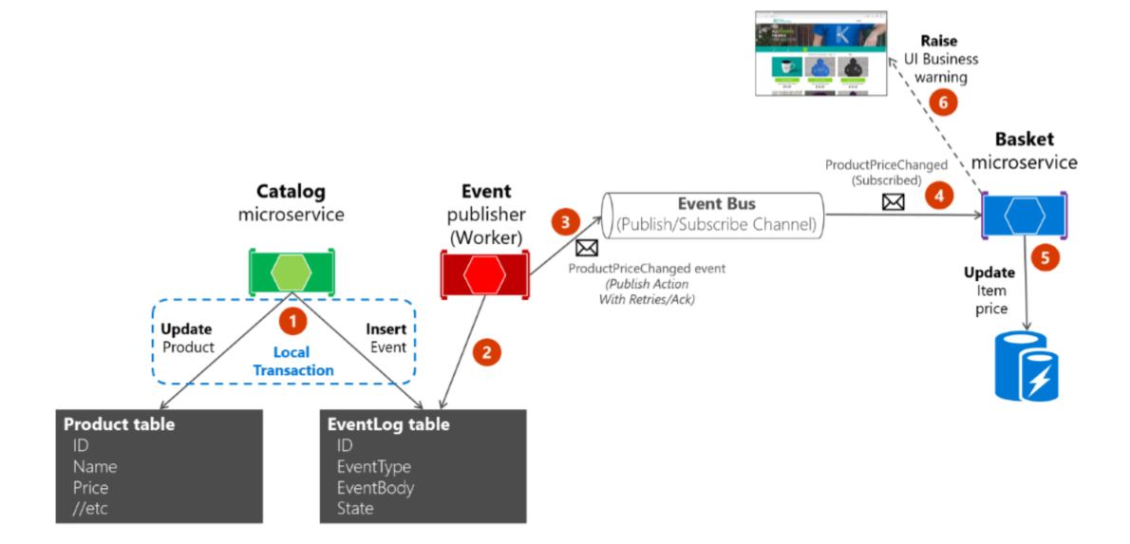
Asynchronous messages – atomicity

Slide 73
The Saga Pattern

Slide 74
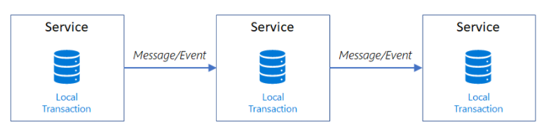
The Saga Pattern
Provides transaction management using a sequence of local transactions
If a local transaction fails, you need to retry
Challenging from implementation and debugging perspective

Slide 75
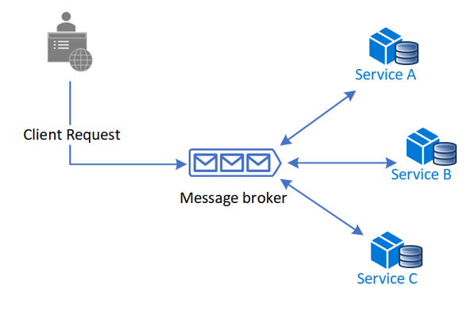
Choreography
Saga is coordinated without a centralized point of control
Simpler for implementation but workflow may be confusing

Slide 76
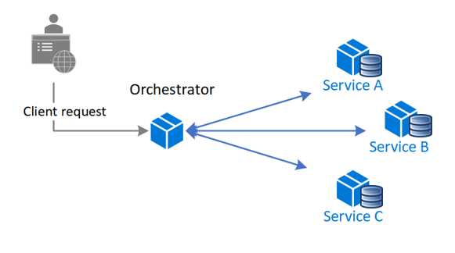
Orchestration
Saga is coordinated with a centralized controller
Additional point of failure but better workflow control

Slide 77
OTHER Considerations

Slide 78
VERSIONING
Each microservice represents a public contract
It is important to deployed changed public URLs as new versions
While the old URLs are still working
You can’t force all clients to redeploy and update right away

Slide 79
addressability
Each microservice should have a unique name
And it should be discoverable no matter the infrastructure below them
You should use a service registry
A highly available and up-to-date database
Containing network locations of service instances
Most clusters already have a service registry included

Slide 80
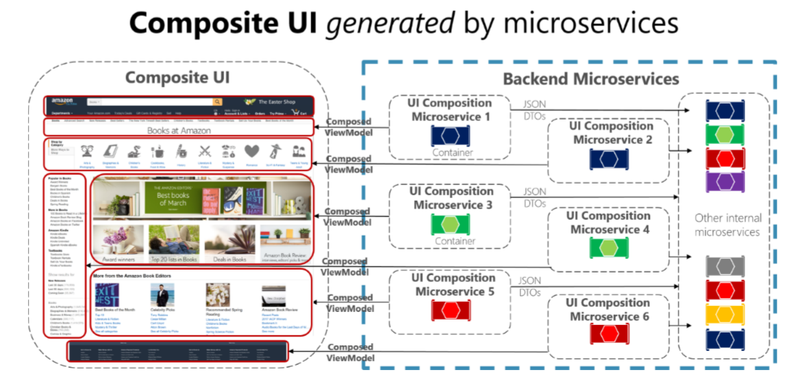
UI Based on Microservices

Slide 81
HEALTH
Often overlooked, but each microservice should report health
Periodic checks for:
CPU power and RAM usage
Availability for web requests
Dependencies are working correctly
Log information:
Each event and action from the microservice should be logged

Slide 82
Containers & Orchestration
Containers helps with developing microservices
Easier deployment
Easier onboarding
Better execution environments
Better isolation
Faster initialization
Orchestrators are also in huge help
Easier allocation of computer resources
Easier deployment
Easier load balancing
Easier monitoring and health checks
Plus many more benefits!

Slide 83
Avoiding Disasters

Slide 84
Avoiding Disasters with practical tips
Don’t go polyglot
Using multiple technology stacks makes you reinvent the wheel multiple times
Don’t share databases or table ownerships
Imagine schema migrations and their consequences
Be careful with event logic code
Don’t copy paste code, extract to common classes
But be careful with common classed and logic
Microservices may depend on your changes
Don’t handcraft, use CI/CD
In a such complex solution, many things may go wrong

Slide 85
Avoiding Disasters
Don’t assume the network is reliable and fast
Make sure you have error handling and asynchronous communication
Write tests
For real, write tests – unit, integration, you name it…
Don’t create a SPA monolith
Separate the UI layer to API Gateway microservices
Involve the business in your overall architecture
The domain contexts should be well-defined in the organization
More information in this lecture (you will laugh hard):
https://www.youtube.com/watch?v=X0tjziAQfNQ

Slide 86
Microservices decision tree

Slide 87
The microservices Decision Tree
Are you Netflix?
Are you Amazon?
Do you have serious or worldwide scale and customers?
Do you expect a huge increase in your customer base soon?
Do you have a struggling with performance monolith?
Do you have the recourses to develop microservices?
If any of this is “Yes”, then do them!
It is always better to start with a monolith
And then extract microservices!
Also – make sure every team member is on the same page!

Slide 88
FINAL WORDS before Q & A

Slide 89
Summary
Microservices Architecture
Distributed Data
Event-Driven Communication
Avoiding Disasters
Don't Forget The Optional But Practical Guide-Book
3 Real-World Scenarios
70+ Pages
Free Updates
Get It From The Event's Page or write to wewritesoftware@gmail.com
https://www.eventbrite.com/e/software-architecture-microservices- code-it-up-online-vol-14-registration-262477656737

Slide 90
In the next part
Other Useful Patterns & Anti-Patterns
The Architect Role
Soft Skills Required For A Technical Career
Register here:
https://www.eventbrite.com/e/software-architecture-the-architect-the-team- code-it-up-online-vol-15-registration-265180962397
Don't Forget The Optional But Practical Guide-Book
3 Real-World Scenarios
70+ Pages
Free Updates
Get It From The Event's Page or write to wewritesoftware@gmail.com
https://www.eventbrite.com/e/software-architecture-microservices- code-it-up-online-vol-14-registration-262477656737

Slide 91
Other Goodies
You can check the Code It Up blog and subscribe:
https://codeitup.today
You can watch some of the free videos:
https://www.youtube.com/CodeItUpwithIvo
Clean code & The art of testing
Docker, CI/CD, Redis, Elasticsearch
And many more…
The source code in all free lessons is available on Patreon:
https://www.patreon.com/ivaylokenov
Unrelated to the IT sector but check out my art T-Shirts:
https://way-ve.com/
Use CODE10 during checkout for 10% discount

Slide 92
Past Code It Up Events
You can get the recordings of the past C# events from the event page:
C# Async-Await In Detail
The C# ORM Battle
Docker – From ABC To XYZ
Identity Server Demystified
Eventual Consistency Done Right
Let's Get Functional With C#
C# API Scenarios – REST, GraphQL & gRPC
Past workshops are also available:
C# Multithreading
Domain-Driven Design With ASP.NET Core
Kubernetes For Web Developers
If interested, you can write to wewritesoftware@gmail.com

Slide 93
ANY QUESTIONS?
You can support me and my projects:
Via PayPal: http://paypal.me/ivaylokenov
Via Revolut: @ivaylokenov
On Patreon: https://www.patreon.com/ivaylokenov
On Open Collective: https://opencollective.com/mytestedaspnet
Via Buy Me A Coffee: http://buymeacoff.ee/ivaylokenov
Crypto: http://bit.ly/ik-sponsors
Never expected, always appreciated!
Make sure you check my sponsors!
INDEAVR - https://indeavr.com
Americaneagle.com - https://www.americaneagle.com

Slide 94
Thank You!
Resources: https://github.com/ivaylokenov/Software-Architecture-Series

